Slide 1
Capstone Project #1
Trainee: Esatu Elilo Dulla
Title: Trends of Food Prices in Canada e.g Eggs and Vegetable Oil (2027-2023)
Data Source: Kaggel: https://www.kaggle.com/datasets/roberttarus/canadian-food-prices?utm_source=chatgpt.com
Libraries used: Pandas, Matplotlib, scikit-learn and numpy

Slide 2
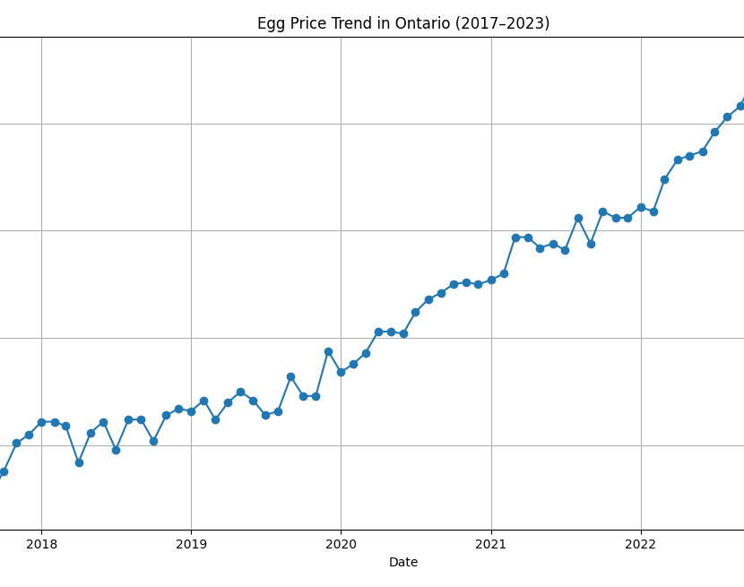
Trends of Eggs and Vegetable Oil Prices in Canada-(2027-2023)
Displays monthly average retail price for 1 dozen eggs in Ontario.
Data covers January 2017 to December 2023.
Prices remained relatively stable until early 2020.
Noticeable price increase began during the COVID-19 pandemic.
Continued upward trend through 2021–2023.
Reflects supply chain disruptions and broader inflation effects.
Suggests need for market resilience planning in agri-food sector.

Slide 3
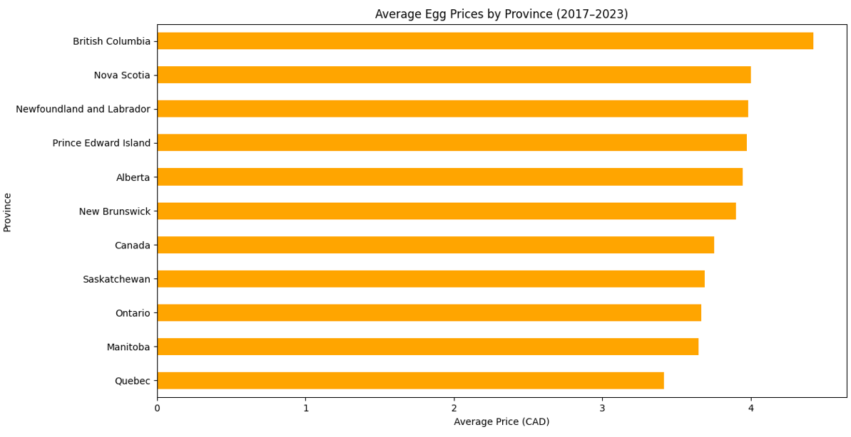
Average Egg Prices by Province (2017–2023
Egg prices vary by province across Canada.
Highest prices observed in remote or smaller provinces.
Regional differences may be due to supply chains or local demand.

Slide 4
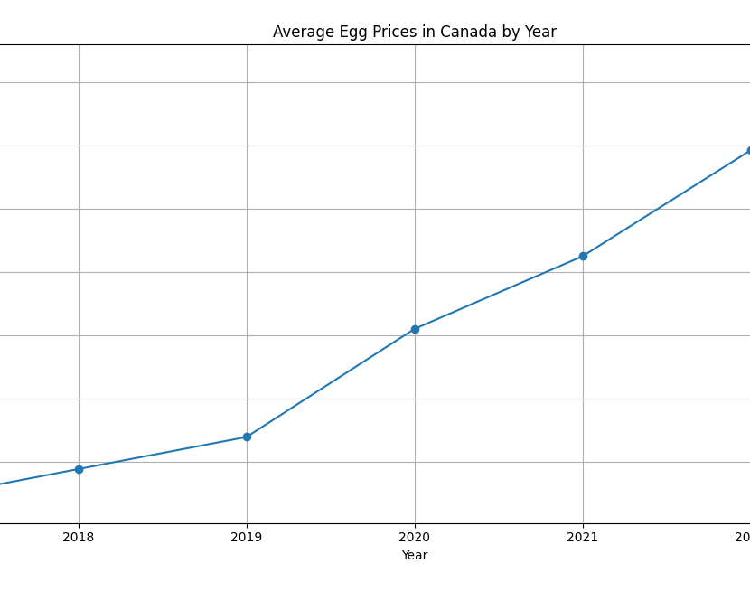
Average Egg Prices in Canada by Year
Prices remained steady from 2017 to 2019.
Sharp increase started in 2020 during COVID-19.
Continued upward trend through 2023.

Slide 5
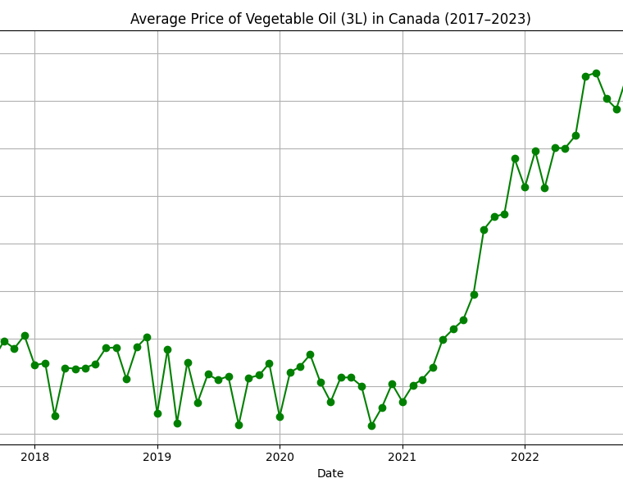
Vegetable Oil Price Trends by Province (2017–2023)
Shows monthly price trends for 3L vegetable oil across all provinces.
Clear upward trend beginning around 2020.Some provinces experienced sharper price increases than others.
Reflects national inflation, supply disruptions, and possible regional differences in food distribution.

Slide 6
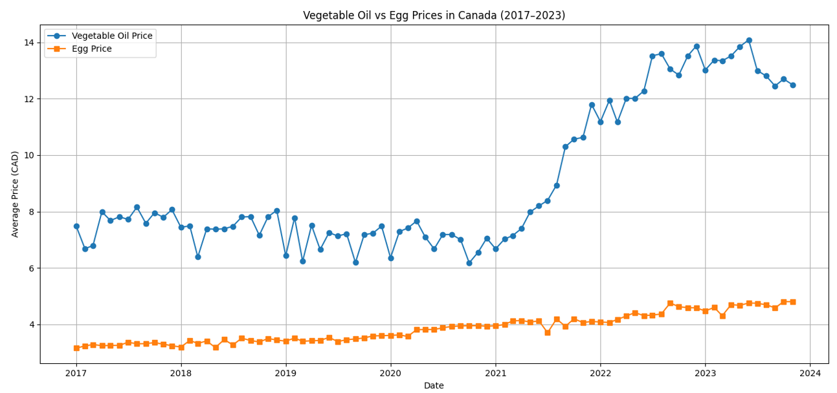
Vegetable Oil vs Egg Prices in Canada (2017–2023)
Compares national average prices of eggs and vegetable oil.
Both products show similar upward trends starting in 2020.
Indicates a potential correlation in food price inflation.

Slide 7
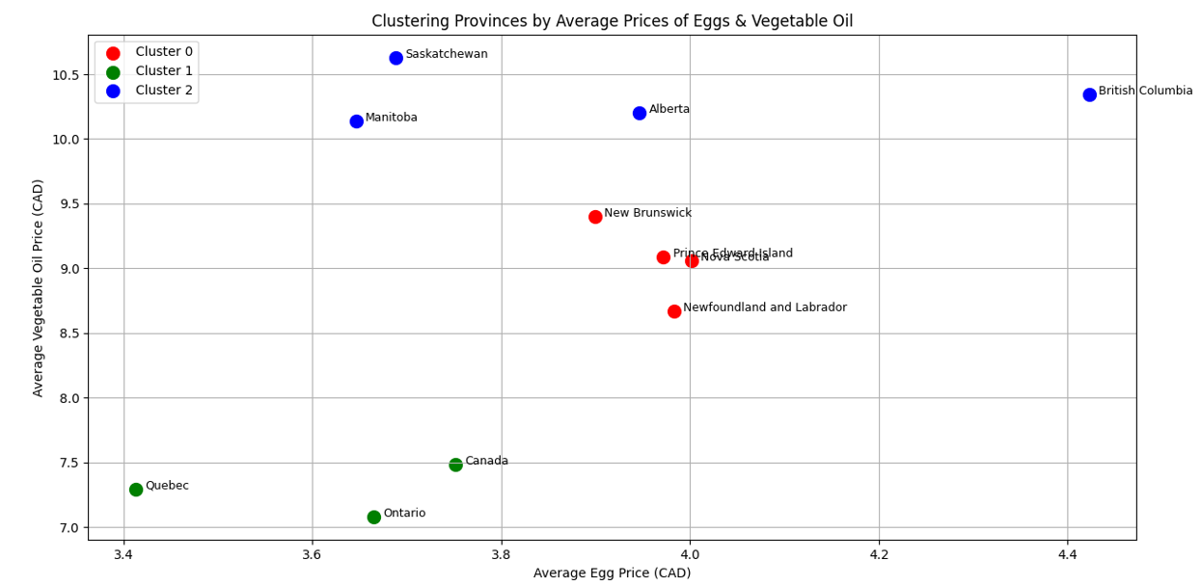
Clustering Analysis of Food Prices by Province
Clustered provinces based on average prices of eggs and vegetable oil
Used K-Means algorithm from the scikit-learn library
Divided provinces into 3 distinct groups with similar pricing patterns
Visualized clusters using a scatter plot with color-coded groups
Helps identify regions with comparable food cost structures
Cluster 0 (e.g., Lower prices) Saskatchewan, Manitoba and Nova Scotia
Cluster 1 (Mid-range prices) Ontario, Alberta & Quebec
Cluster 2 ( Higher prices) Yukon, Northwest Territories & Nunavut
Useful for market segmentation and targeted food policy decisions.

Slide 8
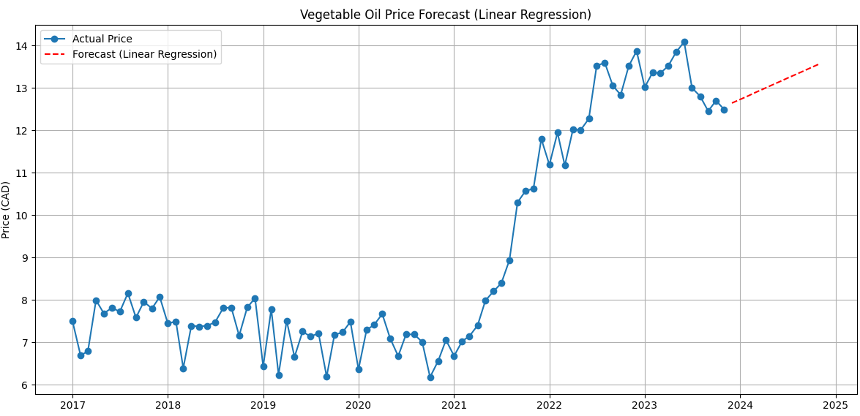
Vegetable Oil Price Forecast in Canada (2023–2024)
Forecast created using Linear Regression on national monthly price data
Price trend shows a steady upward movement from 2017 through 2023
Model predicts a continued rise in vegetable oil prices over the next 12 months
Suggests inflationary pressure will likely persist into 2024 and beyond.
Useful for policymakers and market planners to anticipate cost of essential goods

